Slide 1

Telephone Billing System
By Amardeep Limbu

Slide 2
Introduction
Telephone Billing system is a program that manages telephone record of customer
There are two modes of the program :
Admin mode
Can add, remove, edit and see information about customer records
Passenger mode
Can see how much the total bill will be according to the total calls they have made

Slide 3
objectives
To provide different functions to different roles of users
To be able to add or remove customers for admins
To be able to only specific user to certain menus

Slide 4
Features
Add and Remove customers
Calculate the bill of customers
View the records

Slide 5
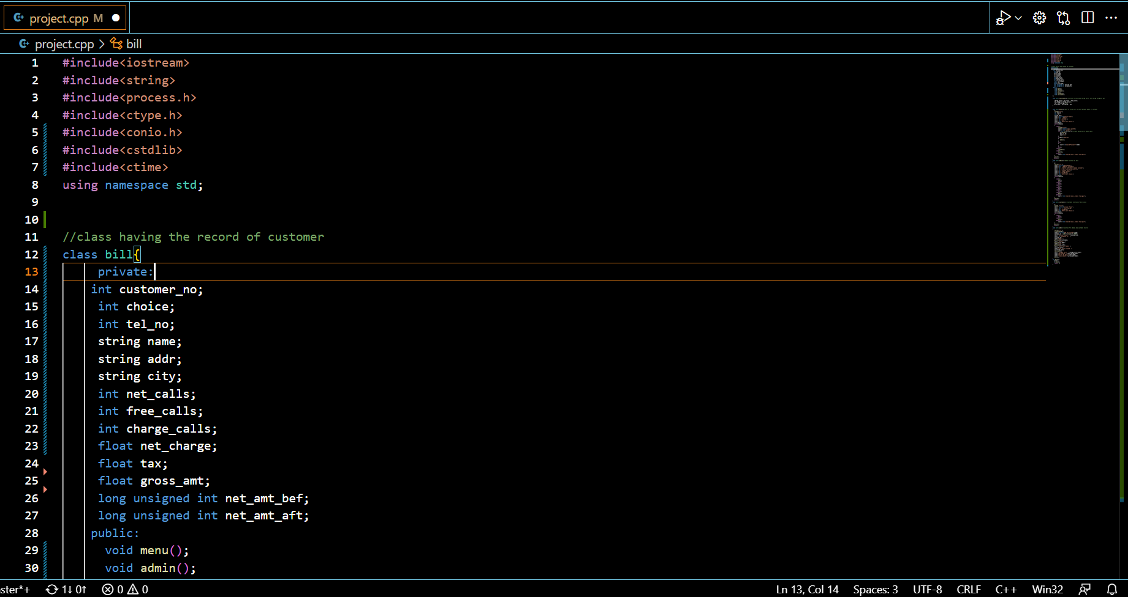
Code:

Slide 6
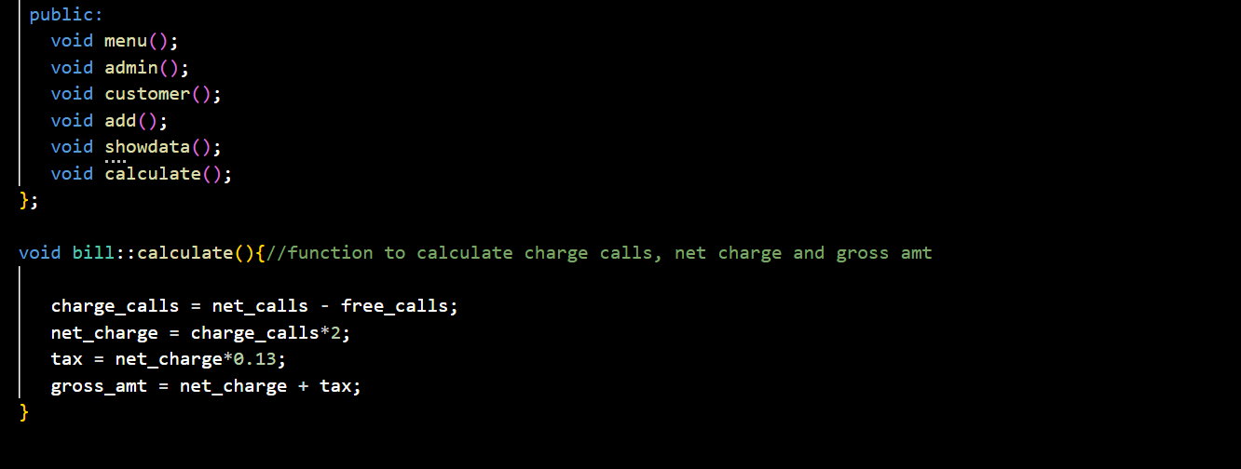
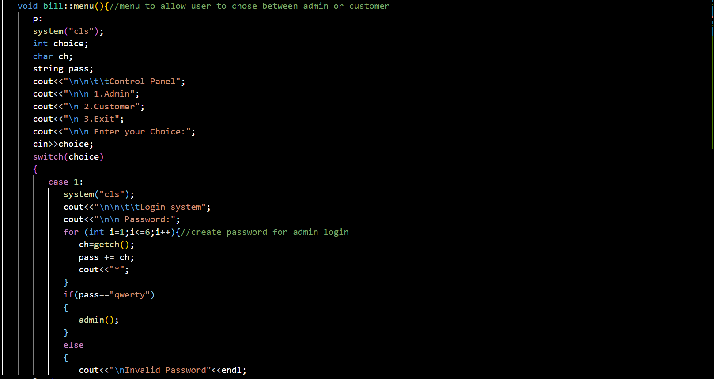

Slide 7

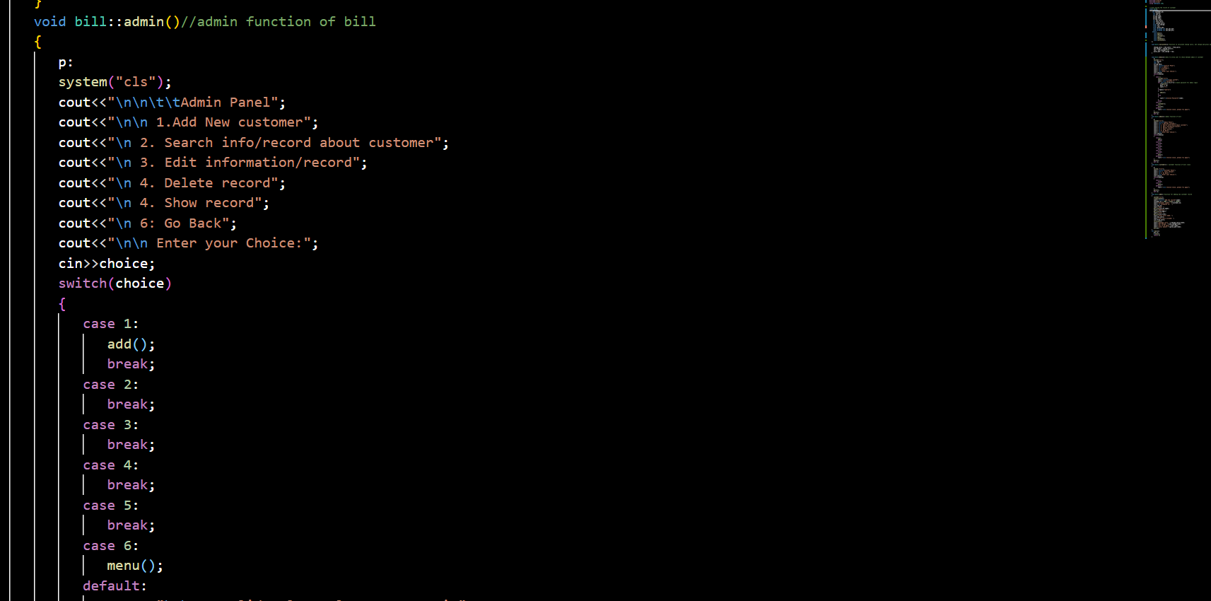

Slide 8
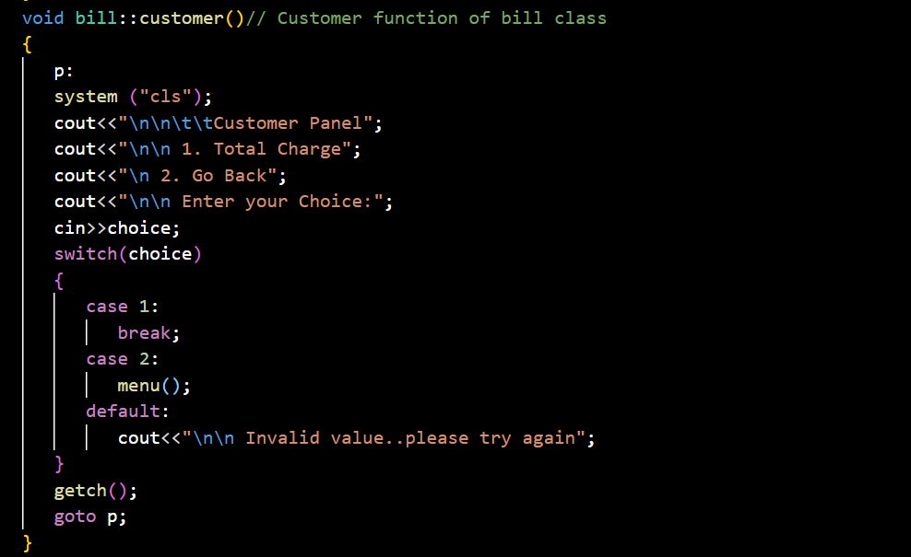

Slide 9
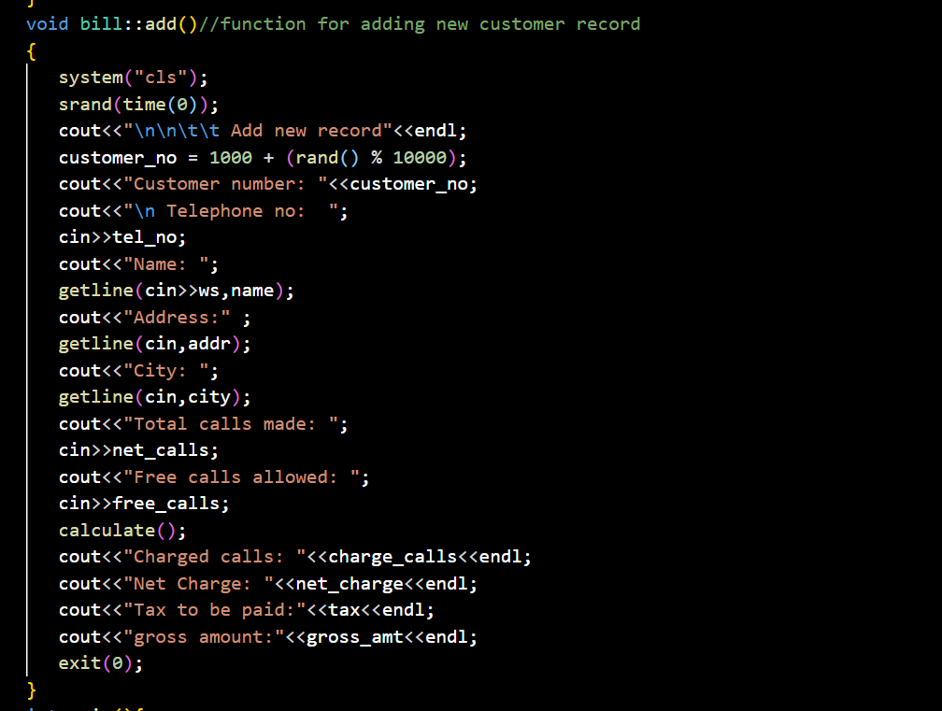
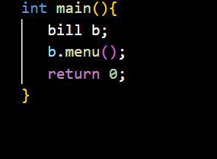

Slide 10
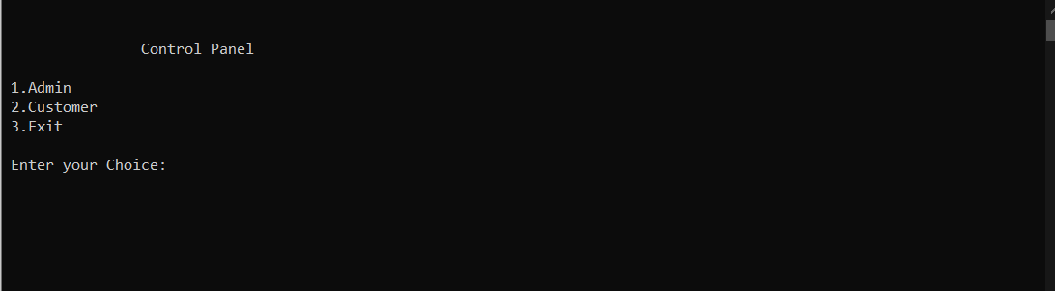
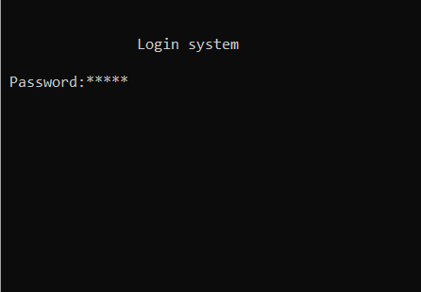

Slide 11
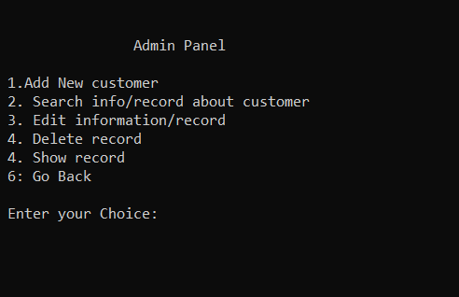
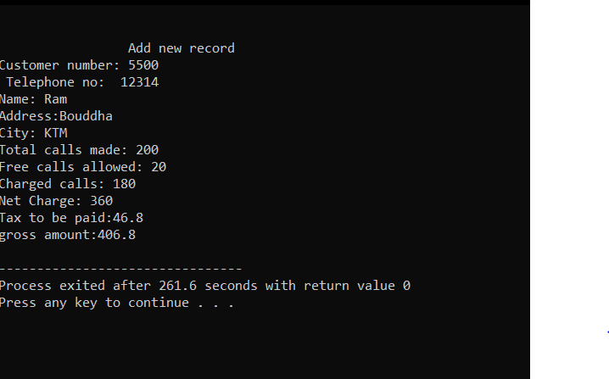

Slide 12
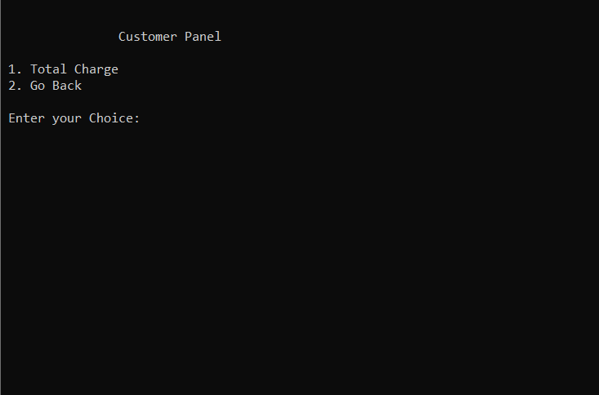

Slide 13
Thank you

